Slide 1

Used for digitizing images.
Features
Carries input straight to the processor without translation needed.
Have evolved from text scanning "wands" to 3D scanners used for industrial design, test and measurement, etc
They are dragged across the surface of the image to be scanned. Therefore, it requires a steady hand, as an uneven scanning rate would produce distorted images
Advantages
Some can also define, translate, and hear printed text, and can also store and beam text to computers and other devices.
Quick & accurate for image input
Disadvantage
Images from a handheld scanner are considered low quality.

Slide 2
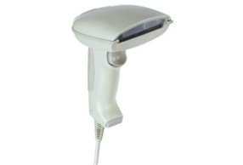
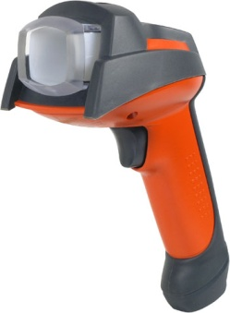
Interview
Interviewed: Everton Grennell
AJ: Is the Handheld Scanner efficient?
EG: Yes it is.
AJ: What do you mainly use it for?
EG: Scanning small documents.
AJ: Why do you prefer the Handheld Scanner?
EG: It is easier to use than the Flatbed Scanner.

Slide 3

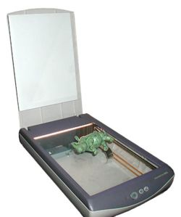
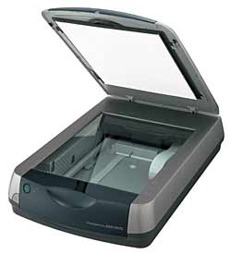
A flat bed scanner is a type of optical that consists of a flat surface on which you can lay documents to be scanned.
FEATURES
It is flat, unlike the other scanners.
It can, therefore, only scan flat surfaces.
It usually has a lid at the top of the scanner.

Slide 4
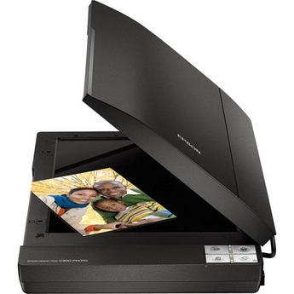
Advantages and Disadvantages of using Flat Bed Scanner:
ADVANTAGES:
A flatbed scanner can’t jam, possibly damaging your documents.
It can scan a page from a bounded book.
DISADVANTAGES:
Images can take up a lot of memory space.

Slide 5
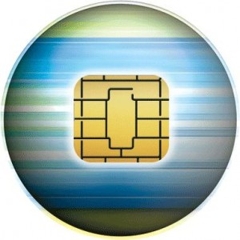
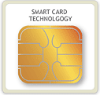
SMART CARDS
Smart cards have very thin gold-colored chips sealed into them can store more information than magnetic strip cards.
Currently these chips are being used for cell phones, debit cards and any prepaid service.
For the future human will advance to using smart cards for storing information on a parsons driving history, birth certificates, finger prints and even retinal scans.
We interviewed Revon Campbell to tell how the smart card has made his life more effective
“I don’t need money to take to the bus anymore, I can use the bus card.”
“It saves time, and makes money easier to carry around”

Slide 6
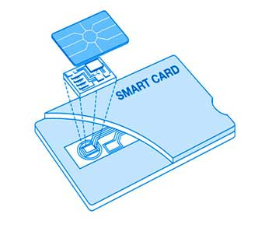
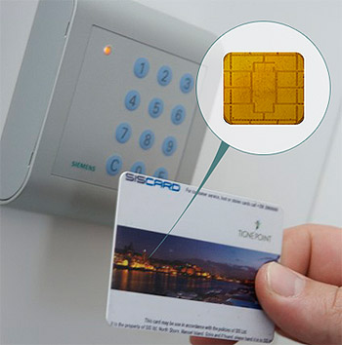
Disadvantages
Advantages
The biggest problem facing smart cards is security and the problem is two fold. The first issue is that not all smart cards are in fact secure.
Flexibility: there is no need, for example, to carry several cards: one card can simultaneously be an ID, a credit card, a stored-value cash card, and a repository of personal information such as telephone numbers or medical history.
The second issue with security involves public perception of the technology. People must believe that the cards are secure.
Security: Smart cards can be electronic key rings, giving the bearer ability to access information and physical places without need for online connections. They are encryption devices, so that the user can encrypt and decrypt information .
A third issue concerns who holds responsibility for the card. If the cash balance is wiped clean by a memory failure, who is liable, the person or the bank?
Other general benefits of smart cards are:
Portability
Increasing data storage capacity
Reliability that is virtually unaffected by electrical and magnetic fields.

Slide 7

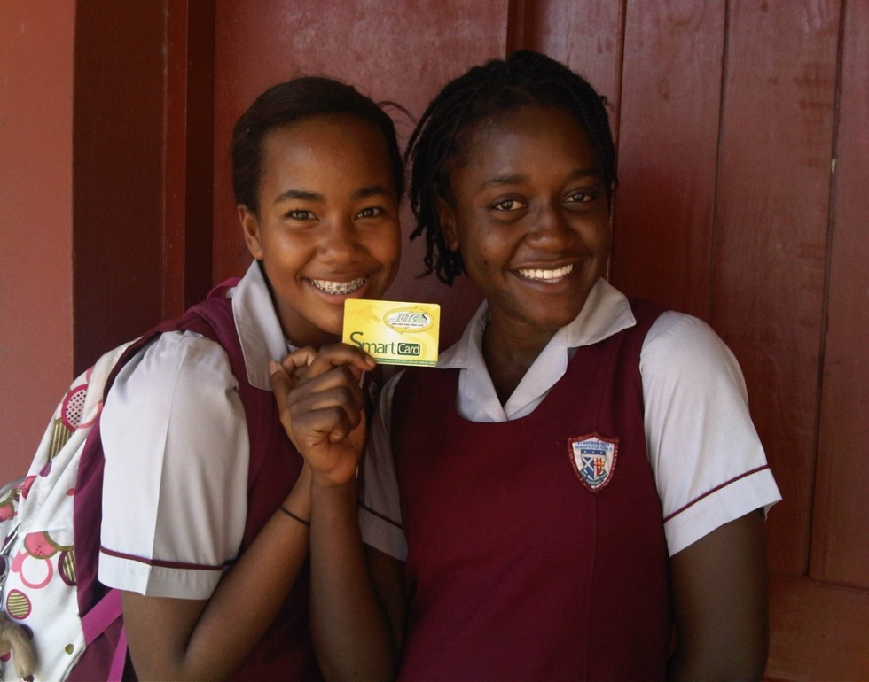
Features
Smart cards have a very thin gold-coloured memory chip sealed into them.
These chips can hold information for cell phone use, debit and credit cards and any prepaid service.
The smart card is able to store more information than magnetic strips
View from an actual Smart Card User
A 37 year old by the name of Dorothy stated that purchasing a smart card for herself and her young son was one of the best things she has ever done. She says that smart cards are affordable and convenient. Dorothy says that she loves the fact that she can carry it around easily in her purse and her son can keep it in his wallet. She controls the amount that is placed on it and can keep a record of how much is being spent each time and her balance.

Slide 8
Advantages & disadvantages of using a smart card
Advantages
Smart card technology isn’t prone to bias and cannot deny access to any person who wants to participate in a network transaction.
Smart cards are very affordable, seeing that they are fairly cheap and they are re-usable.
Disadvantages
Smart card readers are very expensive to produce. These readers are not available in all locations and may have compatibility issues due to the differences of each smart card brand.

Slide 9
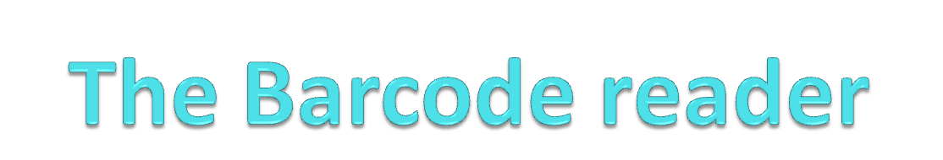
Two Advantages
* Speed of transaction. It is faster than keying in the price manual
* Accuracy of transaction. You do not have to worry about a cashier entering the wrong price.
One Disadvantage
* The system is expensive to set up.

Slide 10
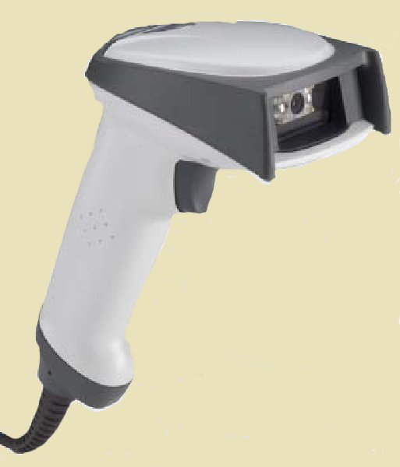
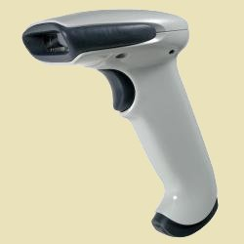
Barcode Reader Pictures

Slide 11
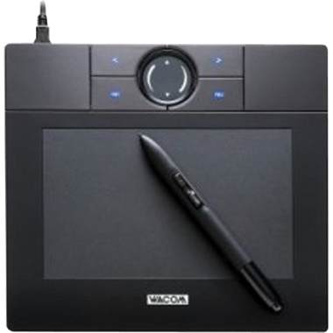
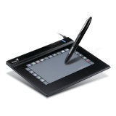
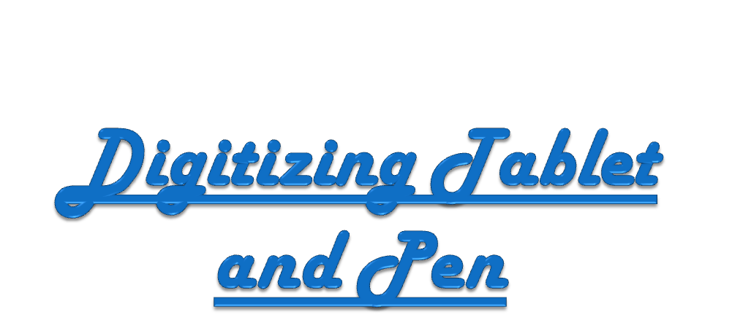
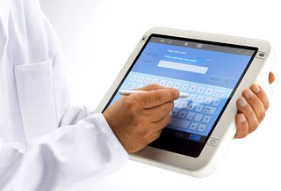
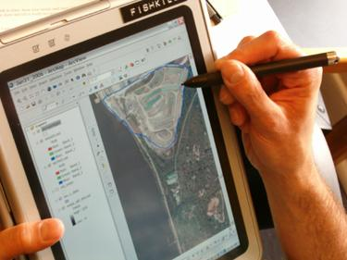
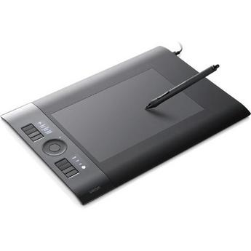

Slide 12

Digitizing Tablet and Pen
Features:
It is an input device
Consists of a pad or tablet and a printing device.
It’s a board which can detect the position of a pointing device like a stylus on its surface.
It has cross-hairs to position it accurately and a number of buttons for different actions.
Advantages:
Graphic tablet offer advantages over both touch screens and ordinary tablets.
Unlike touch screens, they offer pressure sensitivity, and their resolution is generally higher.
disadvantages
Can be awkward to access menus and make selections. Larger designs (A4 for example) are expensive.

Slide 13
Interview
Interviewer: Who uses the graphic tablet?
Junior: An artist, like me, and persons who suffer from getting wrist cramps.
Interviewer: What is the best thing about using this device?
Junior: It makes it easier for me to convert my drawings into digitized images.
Interviewer: Does it result in more refined pictures?
Junior: Of course, it’s amazing.

Slide 14
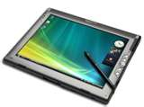
Digitizer Tablet and Pen
A digitizing tablet (graphics pad or drawing tablet) is a type of input device used in conjunction with a mouse or trackball. The tablet consists of two parts, a flat surface for drawing and a pen that is programmed to work with the tablet.
Features
Size- Digitizer Tablets come in different sizes , depending on the user’s wants. If a user (e.g. graphic artist) uses a bigger tablet it therefore means more hand movement. But this may be necessary depending on the work being done.
Pen- The pen is necessary when using the tablet. This acts as the actual pen/pencil when drawing on paper. Some tablets may come with special pens or users just buy one and program it to their device. Some pens use batteries ,have an erasing end or simply just have switches and buttons.
Pressure-sensitivity- Pressure level refers to the sensitivity to pressure on the surface of the tablet. The pressure-sensitivity can control line thickness, transparency, and/or color. The higher the pressure-sensitivity, the more responsive and natural your tablet will feel.

Slide 15
Disadvantage
it has one feature of OCR(Optical Character Recognition) which can recognize written characters and transfer them to computer characters. However this may be hard as the OCR feature may misinterpret the intended character.
Advantages
compared to the usage of pen and paper, artists would prefer the tablet as it has immediate connections to a computer that would be less work for a better presentation.
this device uses the OCR feature which may be helpful to input writings ,example signatures, which can be inputted for the usage of documents.
Digitizer Tablet and Pen

Slide 16
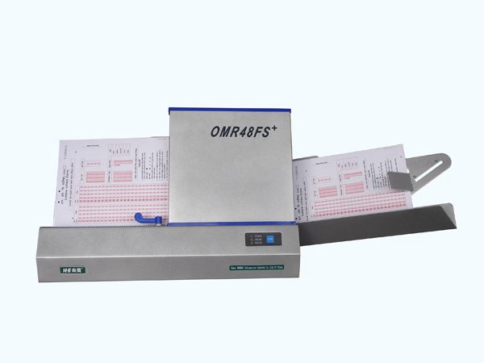
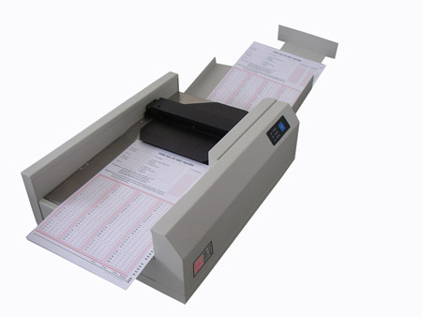
Optical Mark Reader
This is an input device that senses the presence of black marks on white paper

Slide 17
Advantages
Reduced cost of inputting large volumes of data.
Fast method of inputting data.
Less labor needed to input the data.
Disadvantages
If options are not shaded properly the machine may misread selections.
Forms that are creased jam the machine, causing down time.
Badly damaged forms have to be rewritten or keyed in manually.

Slide 18
Optical Mark Reader
Advantages
OMR scanning is fast. An OMR scanner can uphold a throughput of 1,500 to 10,000 forms per hour
OMR scanning is accurate. It consistently provides unrivaled accuracy when reading data.
Disadvantages
As OMR is used to obtain information from the general public clear instructions on how to mark their choice should be provided, apart from clear instructions which are generally practiced when OMR is used, there is still a high rejection rate from the OM reader as they are being wrongly filled.
As the reader is quite sensitive the forms should be in perfect condition, if they are crushed or even folded it may be rejected by the OM reader.

Slide 19
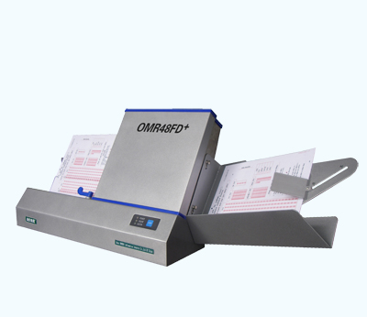
Features
Software solution for collecting data on plain paper forms from tests and surveys.
Calculates statistics including: average, highest score, lowest score, total scores of all testees, question number with incorrect responses, etc.
Used to grades tests, verified database & tallying surveys

Slide 20
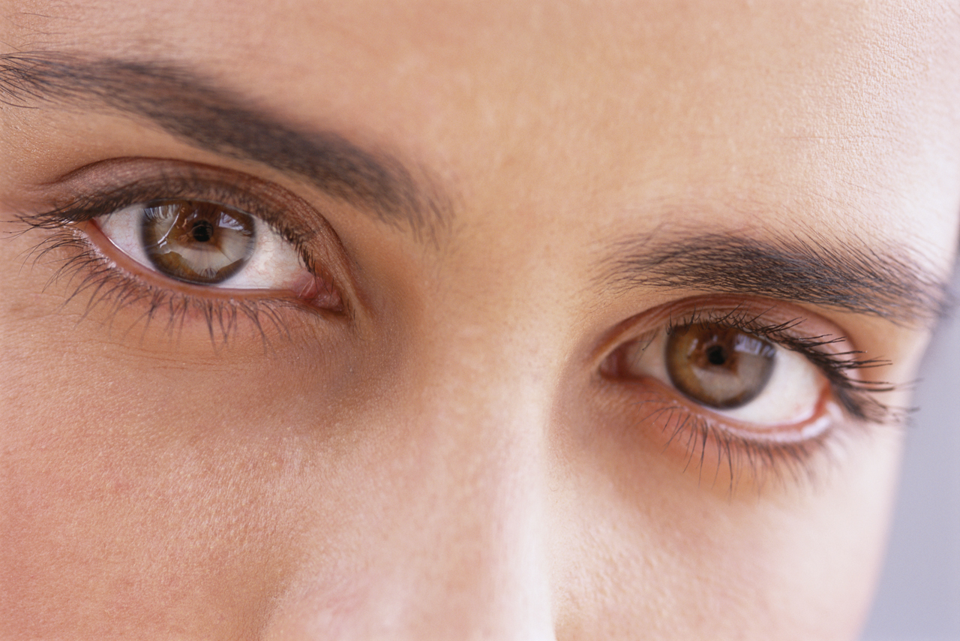

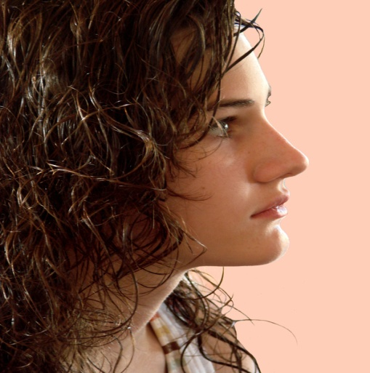
Biometrics refers to the science of identifying an individual through their body characteristics. It comprises of a method for uniquely recognizing humans based upon one or more physical or behavioral traits.
Features
Face geometry-- facial structure; iris/retinal scan;
vein pattern; voice pattern
Hand geometry– fingerprints
Distributions are complex;
A lot of data required to model;
Raw images must be aligned and scaled;
Able to verify an individual just by scanning their eyes, fingers etc.

Slide 21
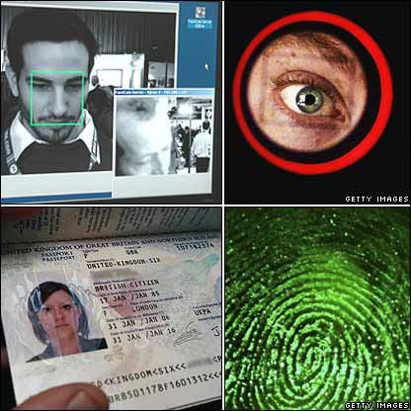
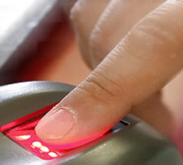

Slide 22
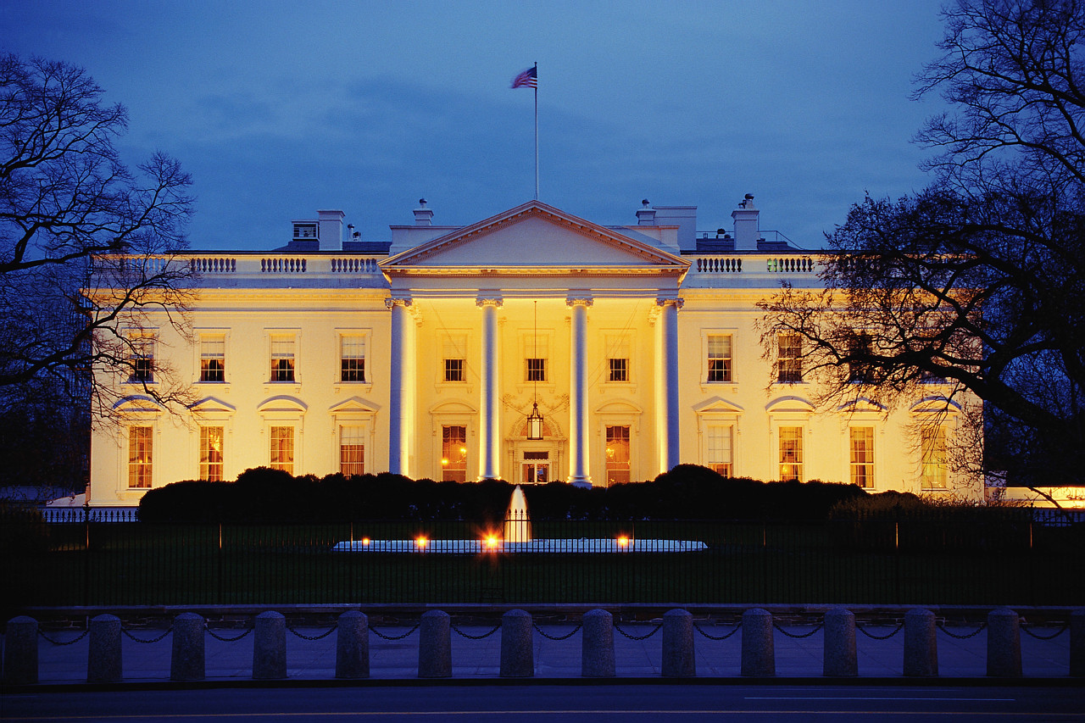
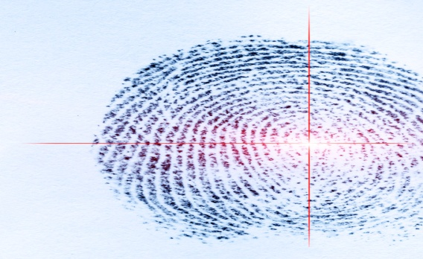
Interview1
Q&A
When did you use this device?
On December 28, 2010
Where did you use it?
At the American Embassy
What feature of this device did you use?
My fingerprints were taken using this device
What happened?
A light flashed across the screen to recognize the fingerprints of the hand placed there, then the image was shown of the pattern of the fingerprints.
How did it feel?
A bit weird. It just felt like placing your hand against a machine. When the light flashed, I didn’t feel anything-- just saw it.

Slide 23
About Biometrics
Advantages
Increases security
Identifies the correct person immediately since no two persons are similar.
Replaces hard-to-remember passwords which may be shared or observed.
Makes it possible, automatically, to know who did what, where and when.
Disadvantages
Some access are simply not fit for everyone. (e.g. Eye scans are not suitable for persons with highly light-sensitive eyes or those with eye damage; fingerprints can be easily altered due to lacerations or other injuries.) Constant changes and updates to the system would have to be made in order for the system to keep track.
When a person ages their voice changes. Also when a person has a cold, sore throat etc., the voices changes. Therefore this method of verification may not work all the time.
Interview 2
(with NASA Brevard County Government )
Why are biometrics better than passwords?
-Biometrics are better than passwords because whereas passwords can be hacked and broken into, biometrics are apart of a person and therefore cannot be taken control of legally in an easy manner.
Why are biometrics a great investment regardless of the great expense that comes with buying them?
- In big or private businesses, there are a lot of information held within the business that has to be kept private at all times. With the increase of the technological field, a business is able to use a system that will ensure the safety of such information thus giving the company a feeling of security. Therefore, it is better to spend a lot of money that will eventually pay off than to loose vital information to outsiders.
Who are biometrics mainly used by?
- Biometrics are used by anyone or any company that has vital information to protect within their business and need an efficient way of doing so.

Slide 24
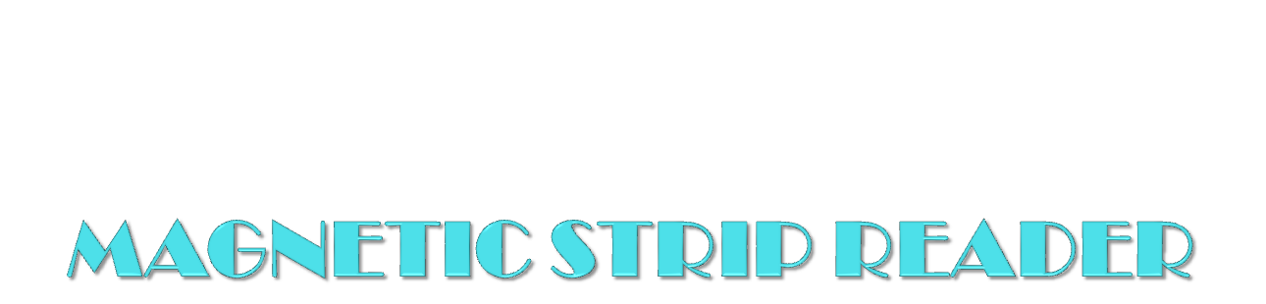
Three features
reads the information encoded
read by a computer program through a serial port, USB connection, or keyboard wedge.
Read high and low coactivity magnetic stripe.
Interview
We interviewed a man who uses this device almost everyday at work.
He said ‘ this device is very fast and easy to use just with one swipe I can get my money and go along my way’.

Slide 25
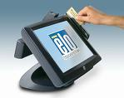
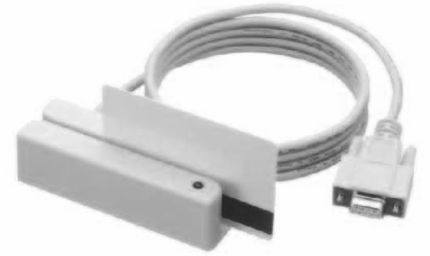
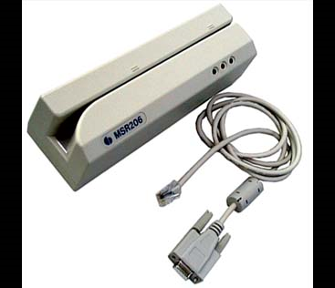
MAGNETIC STRIP READER
Advantages
It is secure since it is not in human readable form
Easy to operate by untrained user
Disadvantages
It does not work in a distance, thus it requires close
contact with the reader

Slide 26
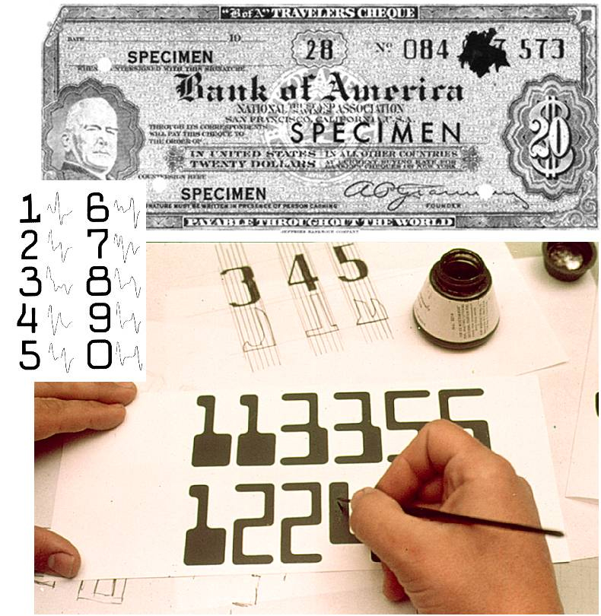
WHAT IS IT? & WHAT IS IT USED FOR?
Magnetic Ink Character Recognition (MICR)
The Magnetic Ink Recognition (MICR) is used mainly in the world of banking to process cheques written daily. It reads a cheques:
Number
Bank branch number
Costumers account number etc.
The technology allows computers to read information of printed documents. The MICR font most widely used is known as E13B, this consists of 14 characters and digits 0-9 and 4 special
characters.

Slide 27
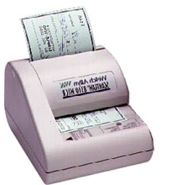
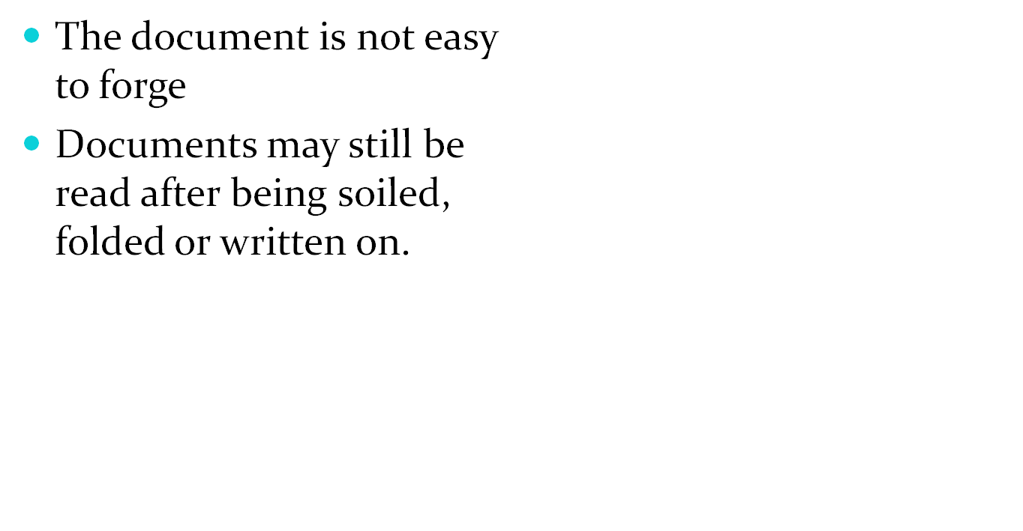
(MICR) ADVANTAGES
Magnetic Ink Character Recognition (MICR)

Slide 28
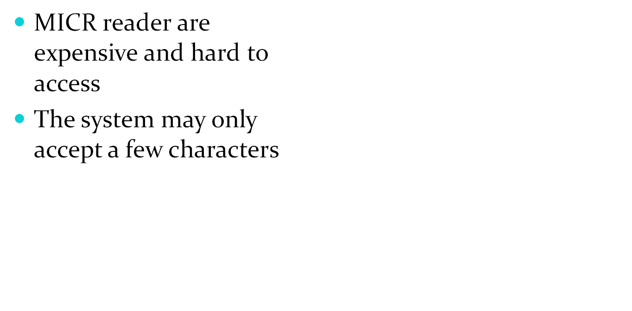
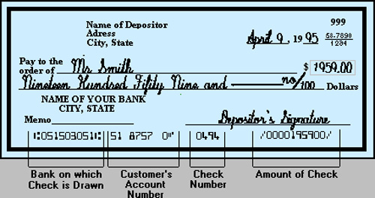
(MICR) DISADVANTAGES
Magnetic Ink Character Recognition(MICR)

